Slide 1
Entrepreneurial Learning in Informal Apprenticeship Programmes: Exploring the Learning Process of the Igbo Apprenticeship System (IAS) in Nigeria
Theme: Towards Disruptive Sustainability: New Business Opportunities and Challenges
Bridget Irene, Joan Lockyer, Chioma Onoshakpor, Eunice Oluwakemi Chukwuma-Nwuba, Siona Cynthia Ndeh

Slide 2
Background 1
Context of Entrepreneurial Learning
Research shows that:
Entrepreneurial learning mostly occurs while ‘doing’, and then reflecting on ‘doing’ (Vogt, Bulgacov, and Elias, 2022).
An individual’s past and ongoing experiences is important for understanding the complex process of entrepreneurial learning.
Promoting entrepreneurial learning through the apprenticeship model, involves gaining entrepreneurial skills through experience or mastery.
‘apprenticeship is an experience building process that allows the apprentice to learn and relearn while on the job’ (Onwuegbuzie, 2017).

Slide 3
Background 2
Apprenticeship Model in Nigeria
A unique form - the apprentices learn by observation and adoption of the Oga/Masters behaviours.
The apprentices live with the Oga and his family
Works with them for the duration of the apprenticeship -typically six years but may be longer.
The apprentices are nurtured and provided the knowledge, experience, entrepreneurial capabilities needed to start and grow ventures.
IAS apprenticeship scheme foster self-employment and self-sufficiency as a way of life

Slide 4
Aim/Objectives/research questions
Does the entrepreneurial learning process of the IAS apprenticeship model produce more successful entrepreneurial outcomes in Nigeria?
Can the model of entrepreneurial learning process be adapted and replicated outside the context of the IAS?

Slide 5
Theory of Planned Behaviour (Ajzen, 2002 and Sabah, 2016)
Our understanding of planned behaviour is aided by three conceptually distinct views
(a)Behavioral beliefs
(b) normative beliefs
(c) control beliefs

Slide 6
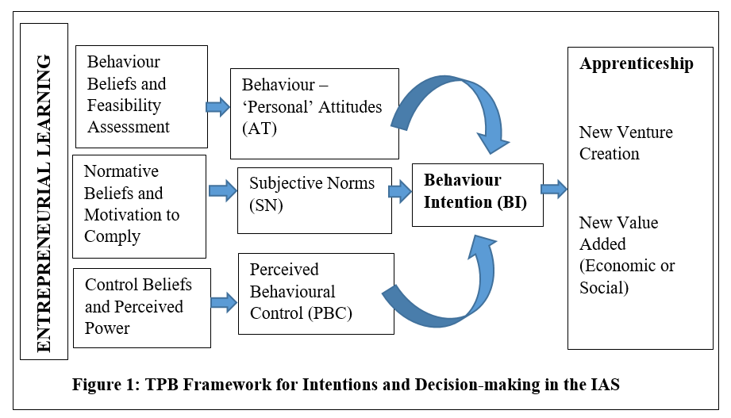
Theory of Planned Behaviour (Ajzen, 2002 and Sabah, 2016)

Slide 7
Research Sample
10 former apprentices from across different sectors
20 current apprentices
Archival records

Slide 8
Methodological approach
The illustrative case study adopted a multi-modal approach for data collection that included interviews with the Masters (employers) and direct participant observations of apprentices by way of daily journal entries.
Thematic analysis
Figure 2: The process tracing (PT) technique used in this study

Slide 9
Power Quotes
“…. being an igbaboi is a blessing. Every young boy in our community looks forward to this opportunity especial an opportunity to learn from a successful Oga. I have to remind myself of that every day and this makes it more important that I do not disappoint my Oga and my family too” (P 9)
Since I joined my ‘Oga’ 6 months ago, every morning after doing the housework, I come to the shop and do the cleaning, arranging and running errands for all the senior apprentices. My ‘Oga’ told me to take my time and observe what everyone is doing so that I can understand it very well before I start doing more harder work” (P5).
“My Oga told me when I started my apprenticeship that I should continue to do the same things every day because practice makes perfect. It was not easy at first to be doing the same thing over and over again, but after sometime, I find it much easier” (P4).

Slide 10
Results and findings
The perceived benefit of participating in IAS (settlement on completion), makes male youths more interested.
Being in good stead with the Masters, shorten the length of time spent, and enhances the skills development process
(positive attitude).
The apprentices' desire to exhibit professionalism and live up to the ‘Oga's’ standards
The families of apprentices encourage participation
(positive subjective norm).
The subsequent mentoring by the ogas on graduation and the daily repetitive tasks produced positive perceived behavioural control.

Slide 11
Contribution to research and practice
This study reports the first use of the TPB to assess predictors of apprentices’ intention to enrol in the IAS.
Attitude and subjective norm were the most important constructs that predicted intention to engage in the learning-by-doing process.
Increasing “social pressure” to engage by the involvement of parents and guardians is the norm and it increases and improves the engagement of the apprentices..
The research also indicate that the learning-by-doing strategy encourages the apprentices to develop learning habits by default through its deep learning component

